Slide 1


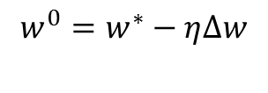

Parallelizing Neural Network for
High-frequency Stock Prediction
Linglin Huang, Chang Liu, Greyson Liu, Kamrine Poels
Gradient Descent Methods
Backpropagation OpenMP/CUDA for BLAS
Node 1
SGD
AdaGrad
Adam
Node 2
Node 3
……
Node 6
Node 7
Notes:
This architecture was called DownPour SGD,and implements data and model parallelism, where a master server is in charge of updating the parameter using a SGD/ADAM/Adadelta optimizer, while the workers asynchronously fetch parameter from the master and computes the gradient in large batches of data.
We implement this architecture in a hybrid program of MPI + OpenMP and CUDA.MPI for the communication between master and workers, OpenMP/CUDA for he heavy computation of gradient.

Slide 2
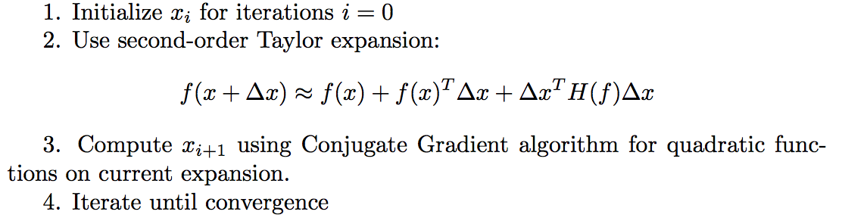
Improvements
Hessian-free
Optimization
(CUDA)
Particle Swarm Optimization
Update best swarm found
Move probabilistically to best swarm position
Swarm 1
Swarm 2
……
Swarm 6
Swarm 7
Node 2
Node 3
Node 6
Node 7
Notes:
All the gradient descent

Slide 3
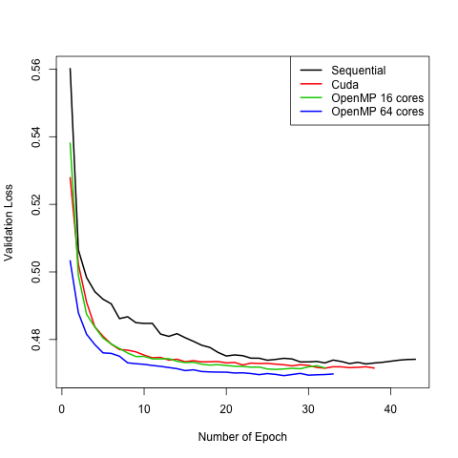
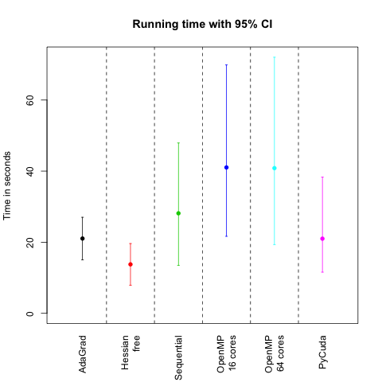
Efficiency Results for Model Replica
Convergence
Notes:
The OpenMP results has fastest convergence

Slide 4
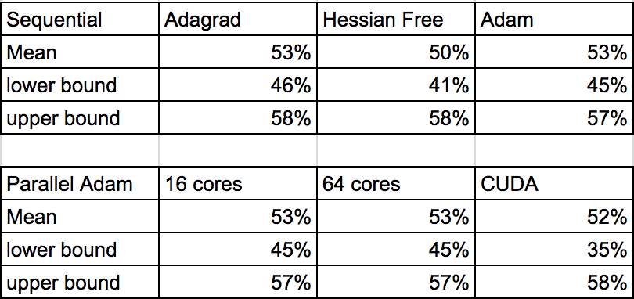
Prediction Accuracy of Direction of Next-second Price Movement
Baseline on test dataset: 41%
Notes:
We preprocessed tick-level trade data from TAQ database for Goldman Sachs in 2016. We calculate a set of momentum technical indicators based on price and volume information, such as Exp moving averages and momentum. These features are then fed into a multilayer neural network (this is 4 layer) to predict the next second movement with an MSE loss function. Then we evaluate the directional accuracy of price movement as well as other metrics. To get a sense of how the random initialization varies the results, we ran 100 models and report the mean and 95% confidence interval for accuracy.

Slide 5
Appendix
http://andrew.gibiansky.com/blog/machine-learning/hessian-free-optimization/
http://www.cs.toronto.edu/~jmartens/docs/Deep_HessianFree.pdf
https://static.googleusercontent.com/media/research.google.com/en//archive/large_deep_networks_nips2012.pdf

Slide 6
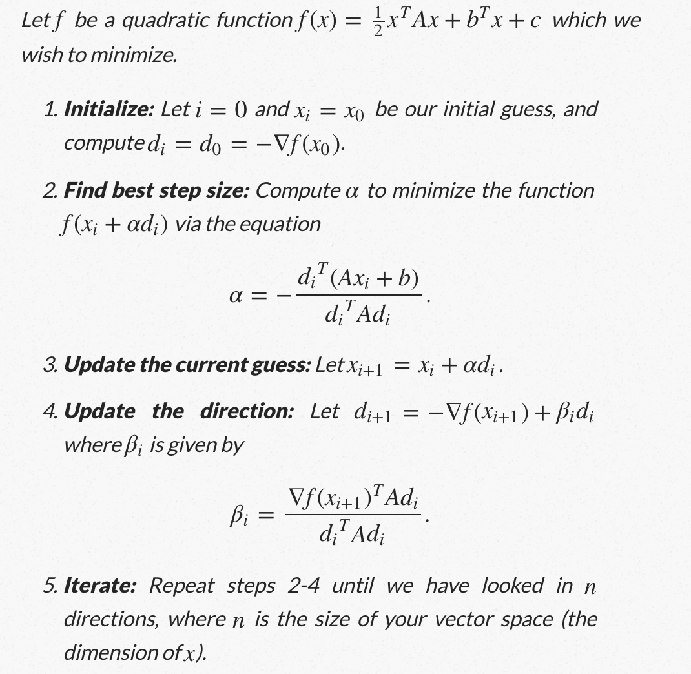
Conjugate Gradient

